Slide 1
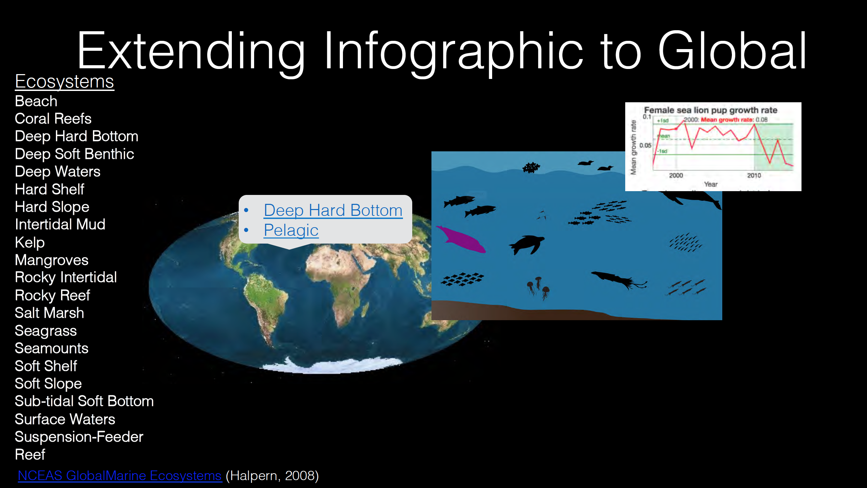

Slide 2
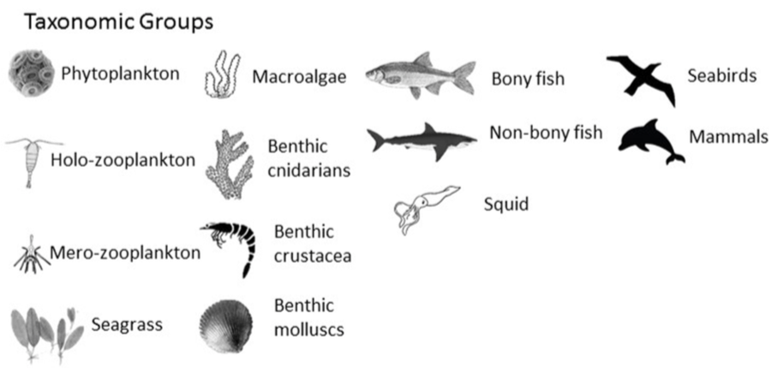





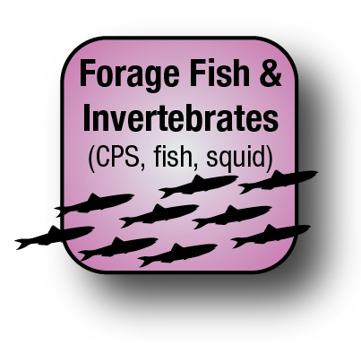
General Icon Types
Biodiversity Metrics
Trophic Groups
Tropicalization?
Other new BD metrics
Focal
Foundation
Keystone
Invasive
Water Quality
Seascapes
Habitat

Slide 3
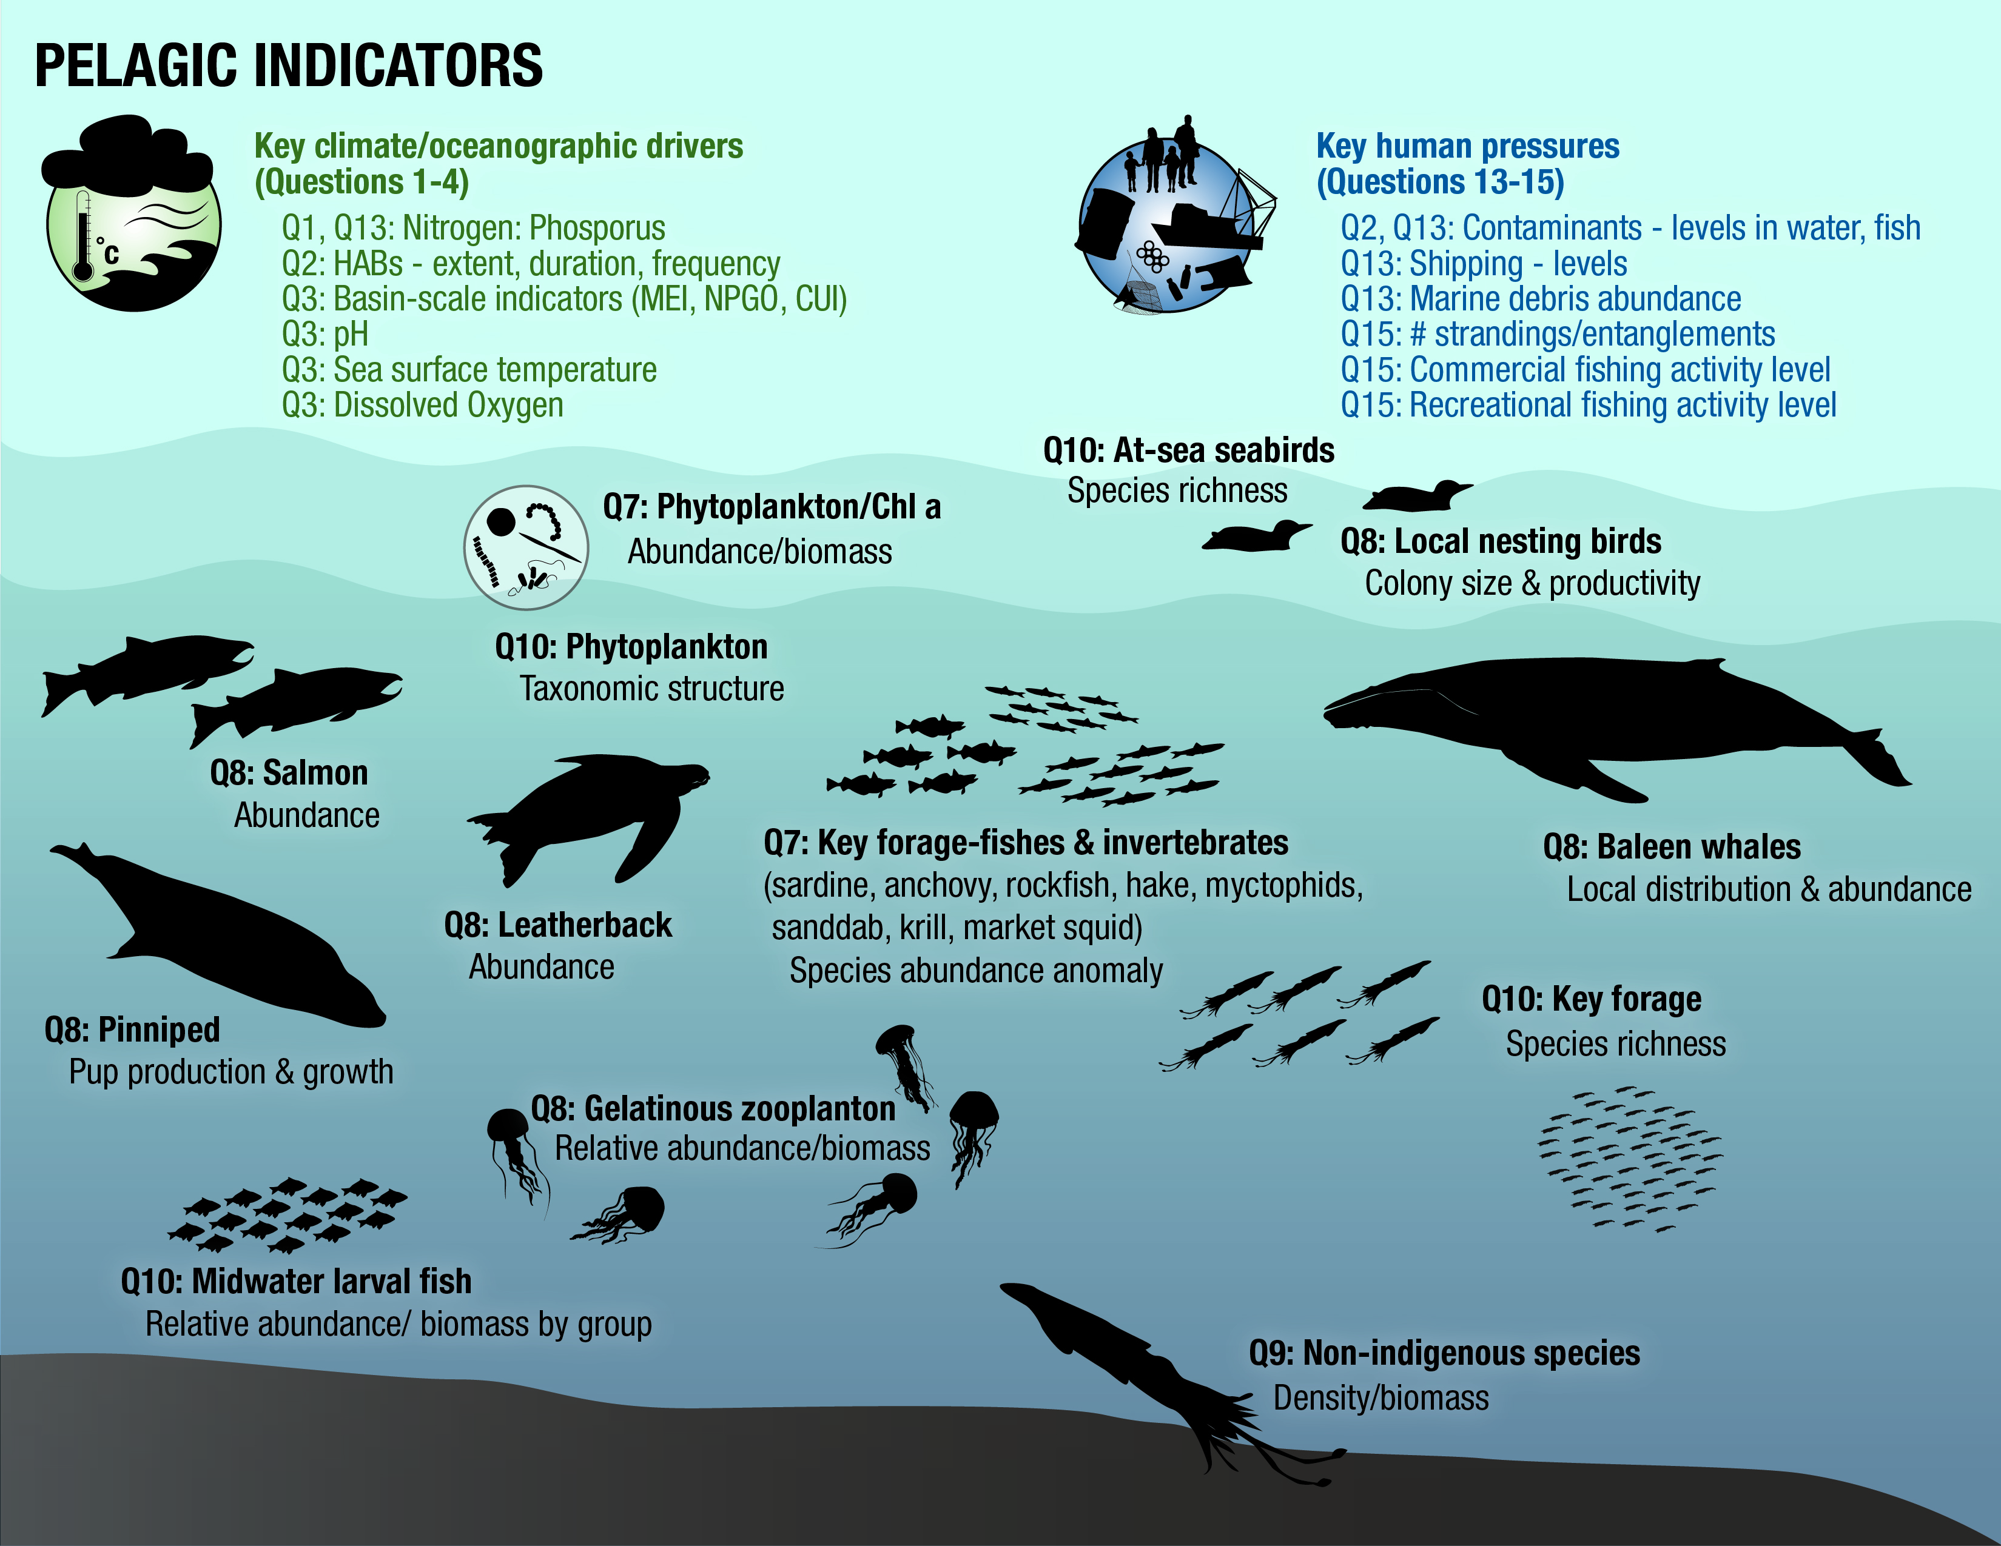
Florida Keyes Icon Types
Chris Anderson with Kathleen
will lead creating icons
Monterey Bay Icon Types
Jenn working with CCIEA designer has quite a few already completed
Other location ?
TBD

Slide 4
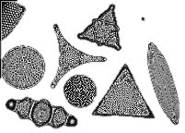
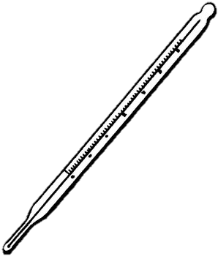


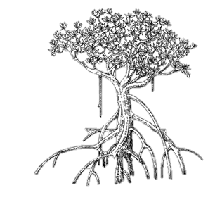
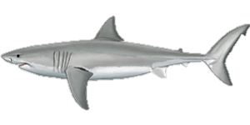


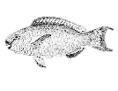
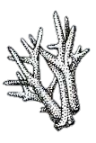

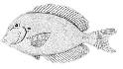
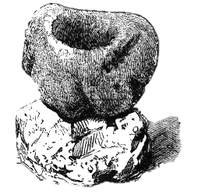
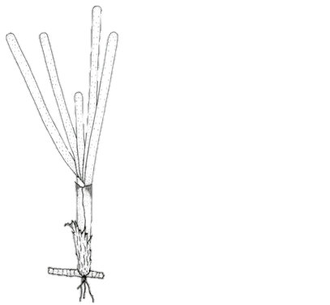
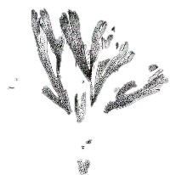
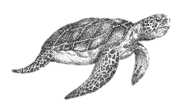
N, P
CO₂
Coral
Carnivores
Herbivores
Producers
Algae
Sponge

Slide 5
The dramatic (and apparently ongoing) separation of the 2013 through 2016 period is apparent from these years being extremely orthogonal to the low productivity years of 1998, 2005, and 2006. Such shifts in the forage base have important implications for seabirds, marine mammals, salmon, and adult groundfish that forage primarily, or exclusively, on one or another component of the forage assemblage.
Figure 38 from McClatchie et al. 2016
Principal component scores plotted in a phase graph for the nine key taxonomic groups of forage species sampled in the central California core area in the 1990–2016 period.
Other idea – this summer Maria is comparing seascapes and forage spp and maybe with biodiversity metrics

Slide 6
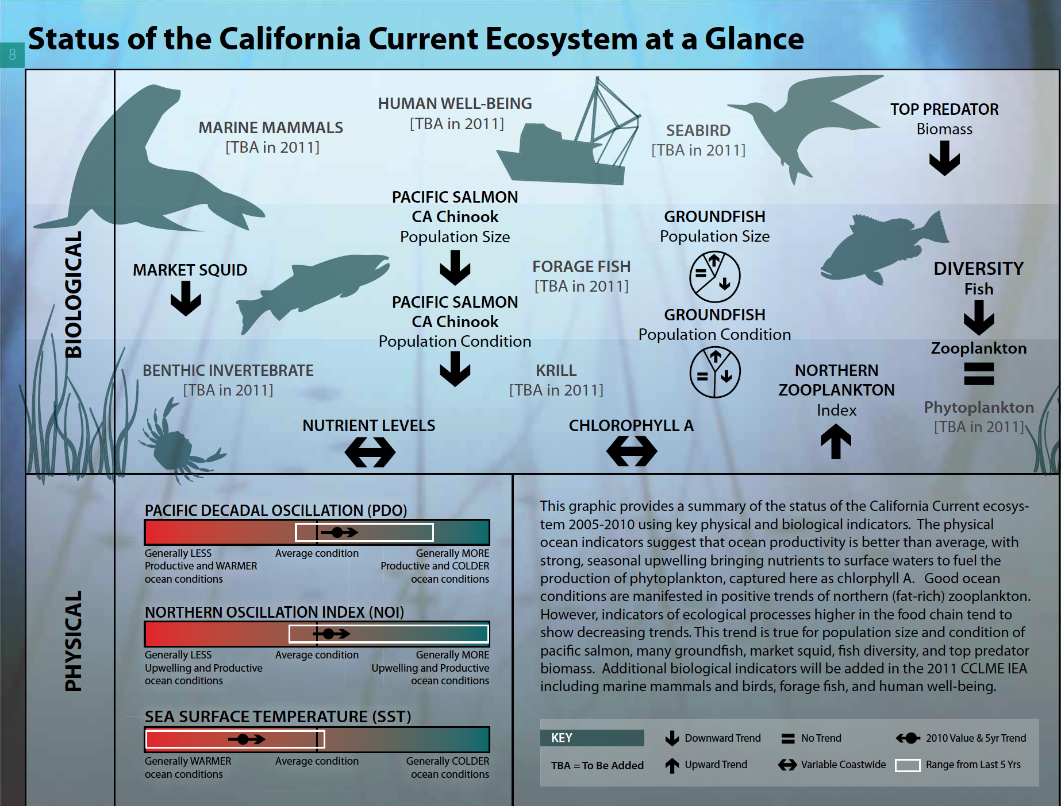

Slide 7
What is Marine Biodiversity?
Define biodiversity (BD) and why we care about it
Explain importance of baseline characterization
Possible Products/Tools include
Species inventory - list of all species documented in an area of interest (characterize spp richness)
EMUs, base maps of habitats, and other baseline habitat characterization
Tool for visualizing existing observations (OBIS, Sea Around Us, VARs, etc) and upload new
How is Marine Biodiversity Changing?
The importance of repeated observations to our understanding of change in BD over time
Differentiate typical conditions from unsual or ‘weird’ events
Products include
Time series plots for target indicators
ID baseline variabily and if variability changing
ID thresholds for normal vs. unusual or ‘weird’ status or trend
Why is Marine Biodiversity Changing?
What are the possible causes of change in BD?
Explain physical drivers (water quality, climate, habitat) and human pressures (extraction, habitat destruction, pollution) on the system and BD
Products
Time series plots, maps or other visualization for drivers and pressures of concern
Analysis tool to determine if drivers or pressures may contribute to observed changes in BD
What Can We Do?
Reiterate why we care about Marine BD
What management actions could help improve status of BD in the area of interest?
MPAs (SDG 14.5)? Water quality regulations (SDG 14.1)? Climate change action (SDg 14.3)?
What can citizens do to positively impact BD?
Personal action e.g., reduce plastics (SDG 14.1)
How can we improve understanding of BD?
Fund monitoring, citizen science, etc. (SDG
Notes:
SDG 14.2: sustainably manage and protect marine and coastal ecosystems to avoid significant adverse impacts, including strengthening their resilience and take action for their restoration in order to achieve healthy and productive oceans.
Value of species inventory
Sanctuaries and other managers of areas want to know what lives there – can’t protect or manage something that you don’t know exists
How do we know if there are invasive species, range shifts or local extinctions if we don’t know the species is present?
Are there certain locations that should be protected or restored because they have unusual high spp richness, rare species, unsual combination of species?
Incorporated eDNA presence data to help fill in the non-managed, uncharismatic and hidden species
Emma Kelley from LME program stated that a desired product would be a species inventory for each LME

Slide 8
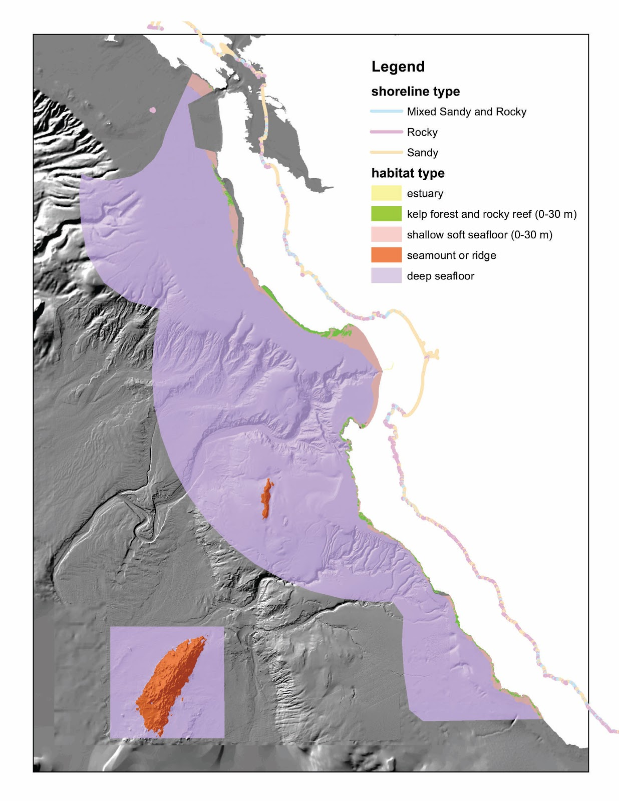

Slide 9
